Slide 1
Referendum Analysis
Group members:李佳任 0510023
劉孟寰 0510022
方鈺豪 0510020
袁鈺勳 0510002
陳以嬿 0086043

Slide 2
Motivation
11/24 Referendum

Slide 3
Data set
Referendum result
Number of people in a household
Household situation
Education level
Marriage situation
Population statistics(including total number, sex ratio, age)
Unit : one village
Data source: Central Election Commission, Ministry of the Interior

Slide 4
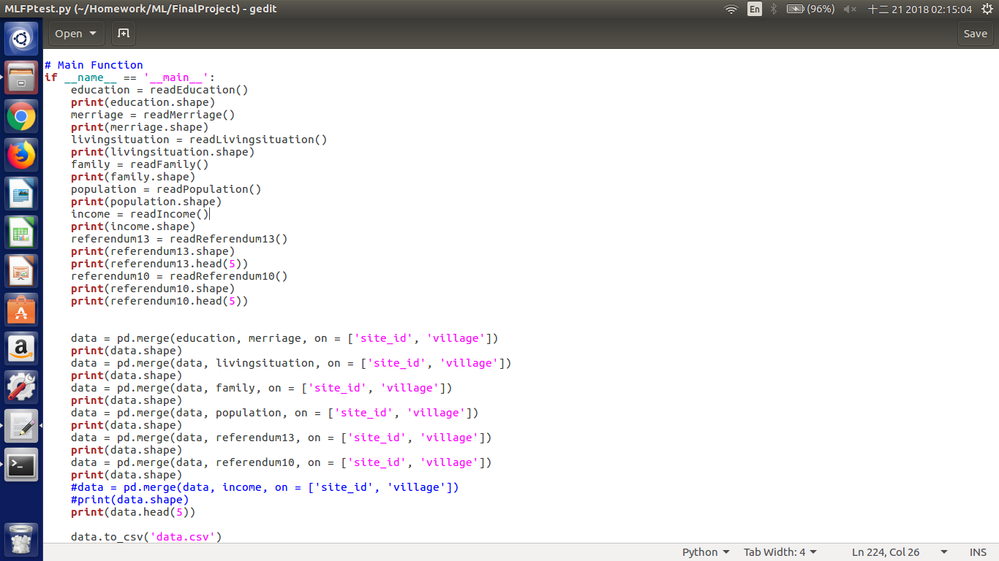
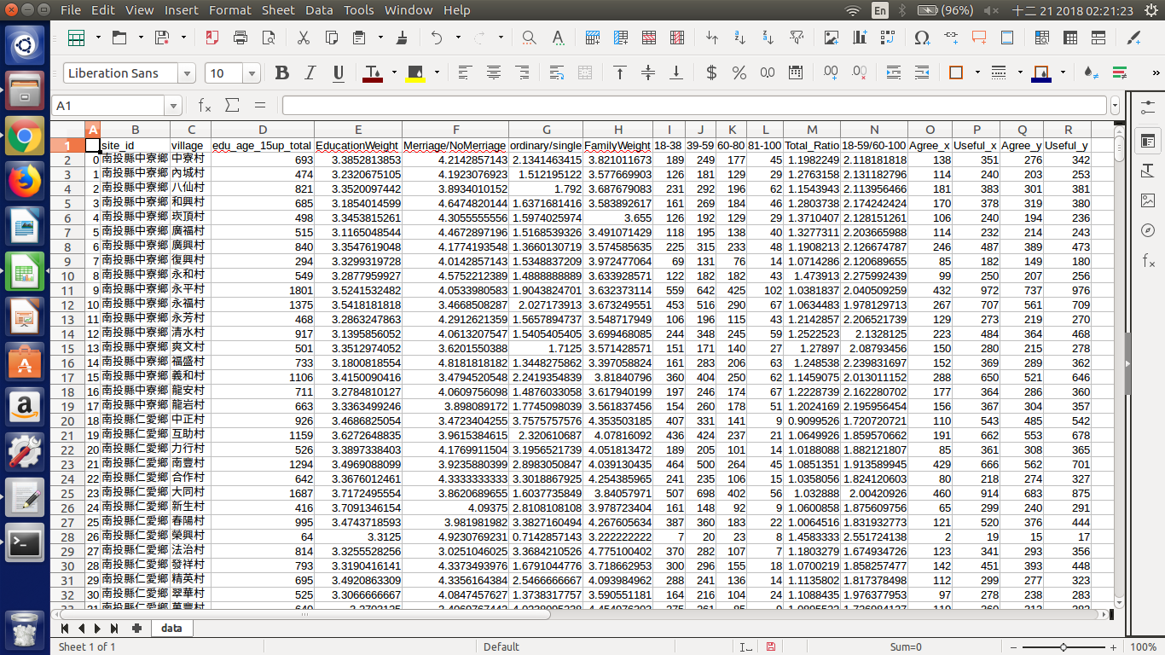
Data process

Slide 5
Definition of features
Target: agree ratio(10th , 13th )
Features:
Total number of people
Sex ratio(number of boys / number of girls)
Weights of age(average age)
Marriage situation(married / single)
Weights of education (average education level )
Household situation( ordinary / single)
Weights of family(Average number of people in a household)

Slide 6
Models used
Decision tree
Knn
Regression

Slide 7
13th result (Taiwan or Chinese Taipei?)

Slide 8
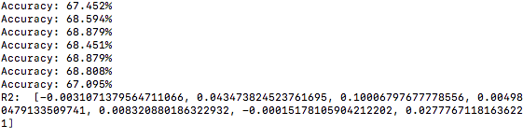
13th result (Taiwan or Chinese Taipei?)
Regression: r2 of each features
Total number | Education weights | Marriage situation | Household situation | Family weights | Sex ratio | Age weights
-0.00310 | 0.04347 | 0.10006 | 0.00498 | 0.0083 | -0.00015 | 0.02777

Slide 9

13th result (Taiwan or Chinese Taipei?)
Regression: r2 of total features
R2:0.24663

Slide 10
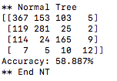
13th result (Taiwan or Chinese Taipei?)
Decision tree: Accuracy of total features
Accuracy: 58.887%

Slide 11

13th result (Taiwan or Chinese Taipei?)
Knn: Accuracy of total features
Accuracy: 56.602%

Slide 12

13th result (Taiwan or Chinese Taipei?)
Regression: r2 of three features(marriage, family, age)
R2:0.0999

Slide 13
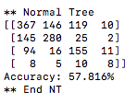
13th result (Taiwan or Chinese Taipei?)
Decision tree: Accuracy of three features(marriage, family, age)
Accuracy:57.816%

Slide 14

13th result (Taiwan or Chinese Taipei?)
Knn: Accuracy of three features(marriage, family, age)
Accuracy:56.317%

Slide 15

13th result (Taiwan or Chinese Taipei?)
Regression: r2 of three features(marriage, family, education)
R2:0.2189

Slide 16
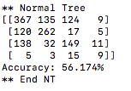
13th result (Taiwan or Chinese Taipei?)
Decision tree: Accuracy of three features(marriage, family, education)
Accuracy:56.174%

Slide 17

13th result (Taiwan or Chinese Taipei?)
Knn: Accuracy of three features(marriage, family, education)
Accuracy:57.031%

Slide 18

13th result (Taiwan or Chinese Taipei?)
Regression: r2 of three features(marriage, age, education)
R2:0.1820

Slide 19
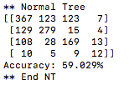
13th result (Taiwan or Chinese Taipei?)
Decision tree: Accuracy of three features(marriage, age, education)
Accuracy:59.029%

Slide 20

13th result (Taiwan or Chinese Taipei?)
Knn: Accuracy of three features(marriage, age, education)
Accuracy:58.958%

Slide 21
Conclusion of 13th
Each one feature: not good
Total features: good, but not very well
Three features:
best: marriage,
family, education
Total number | Education weights | Marriage situation | Household situation | Family weights | Sex ratio | Age weights
-0.00310 | 0.04347 | 0.10006 | 0.00498 | 0.0083 | -0.00015 | 0.02777
Regression: r2 | Decision tree: Accuracy | Knn: Accuracy
0.24663 | 58.887% | 56.602%
 | marriage, family, age | marriage, family, education | marriage, age, education
Regression | 0.0999 | 0.2189 | 0.1820
Decision tree | 57.816% | 56.174% | 59.029%
Knn | 56.317% | 57.031% | 58.958%

Slide 22
10th result (Homosexuality or Heterosexuality?)

Slide 23
10th result (Homosexuality or Heterosexuality?)
Regression: r2 of each features
Total number | Education weights | Marriage situation | Household situation | Family weights | Sex ratio | Age weights
0.22926 | 0.50167 | 0.14915 | -0.00914 | 0.15484 | 0.26347 | 0.06844

Slide 24
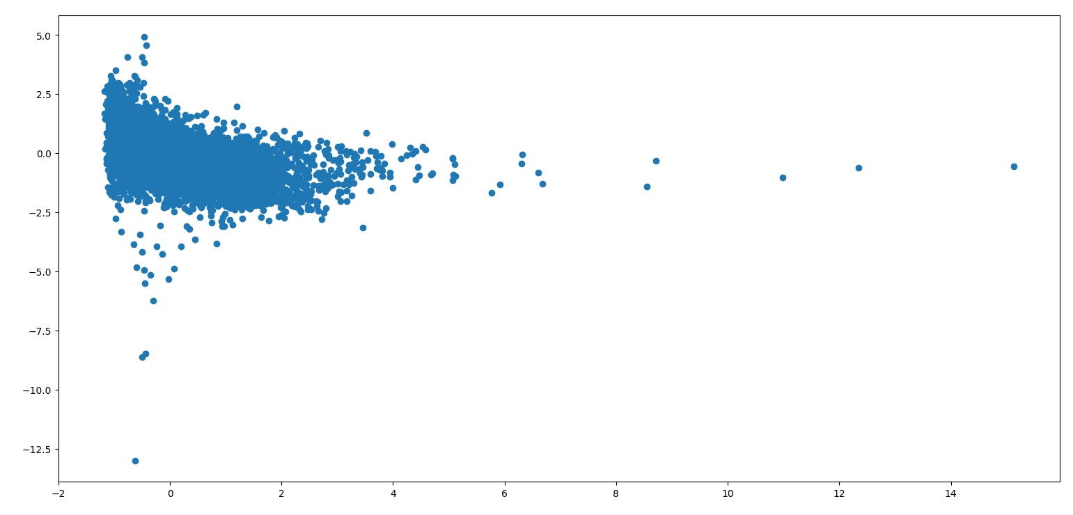
10th result (Homosexuality or Heterosexuality?)
Total number

Slide 25
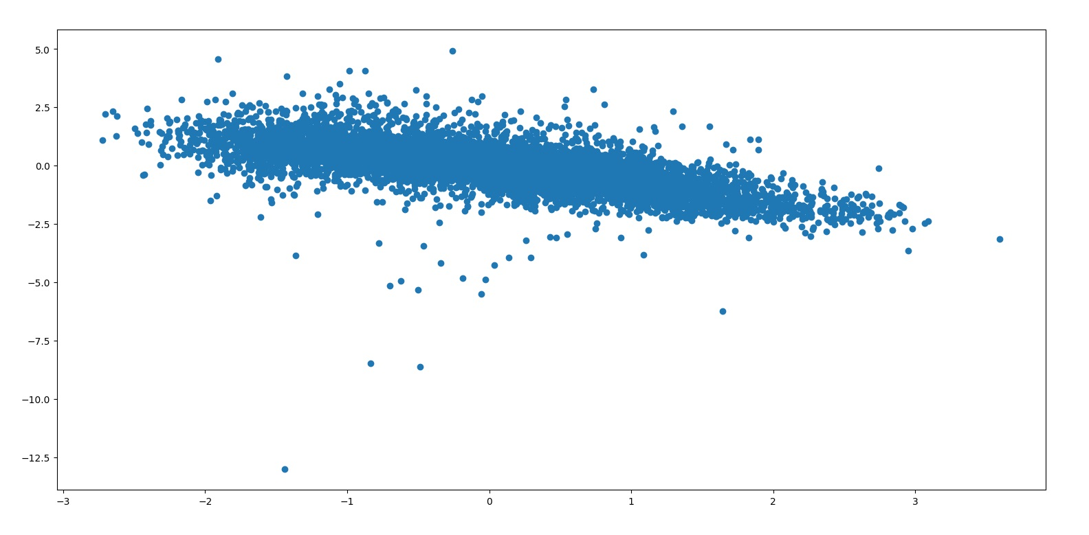
10th result (Homosexuality or Heterosexuality?)
Education weights

Slide 26
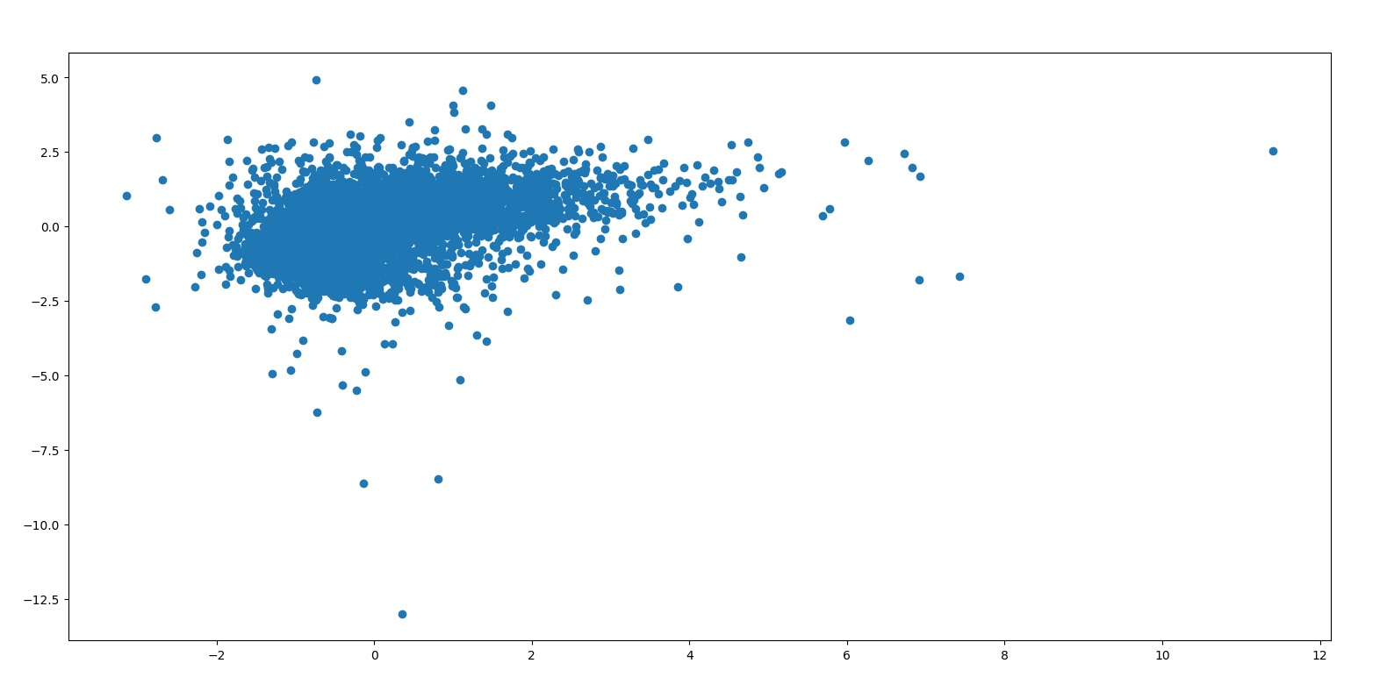
10th result (Homosexuality or Heterosexuality?)
Marriage situation

Slide 27
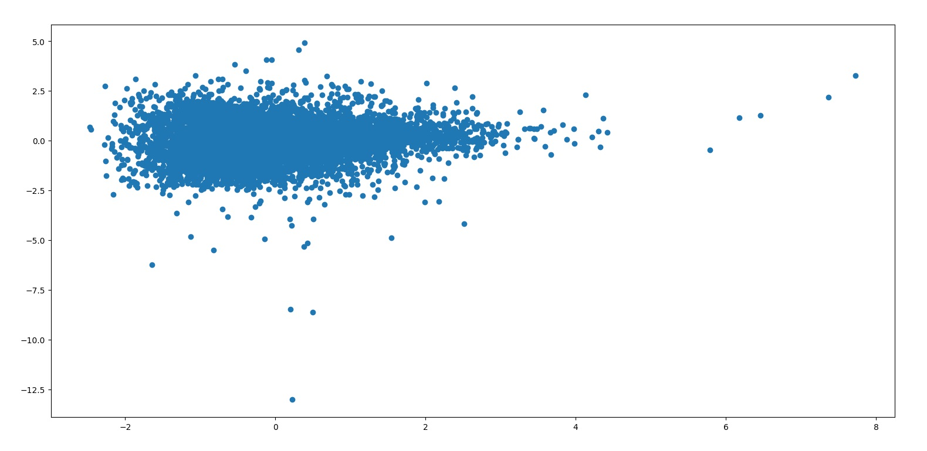
10th result (Homosexuality or Heterosexuality?)
Household situation

Slide 28
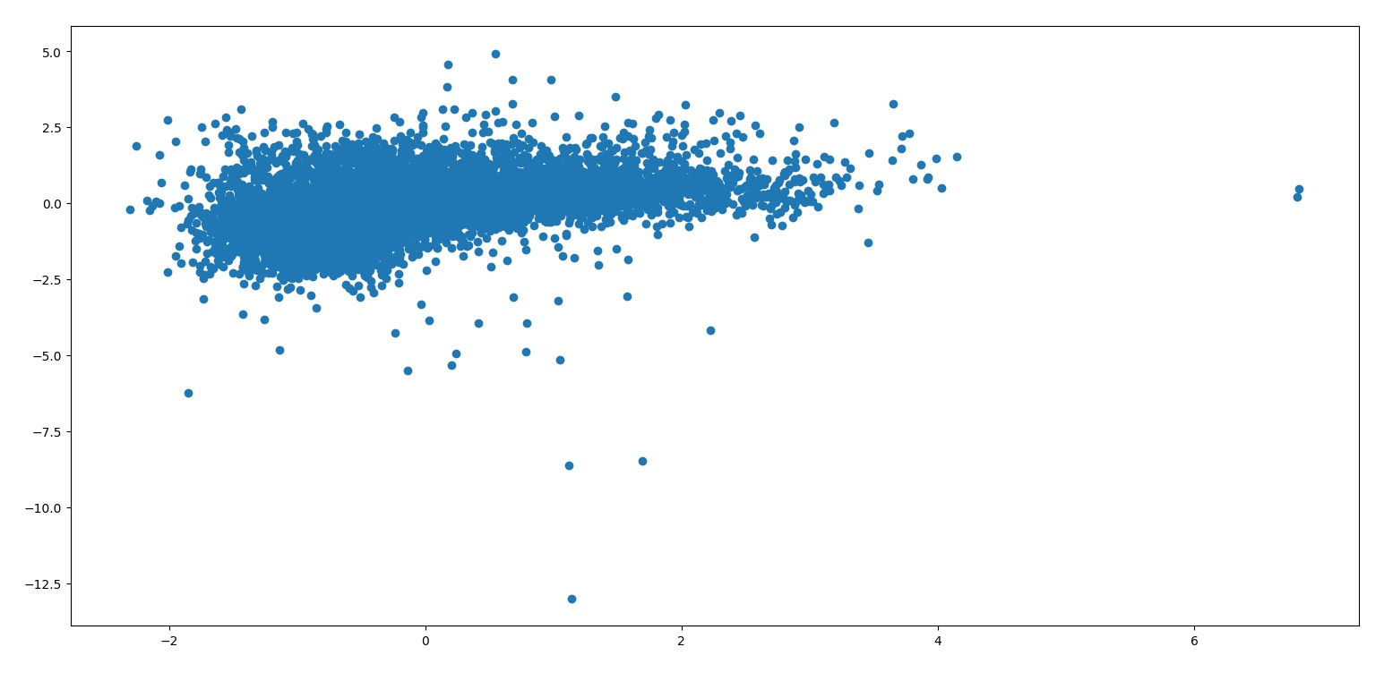
10th result (Homosexuality or Heterosexuality?)
Family weights

Slide 29
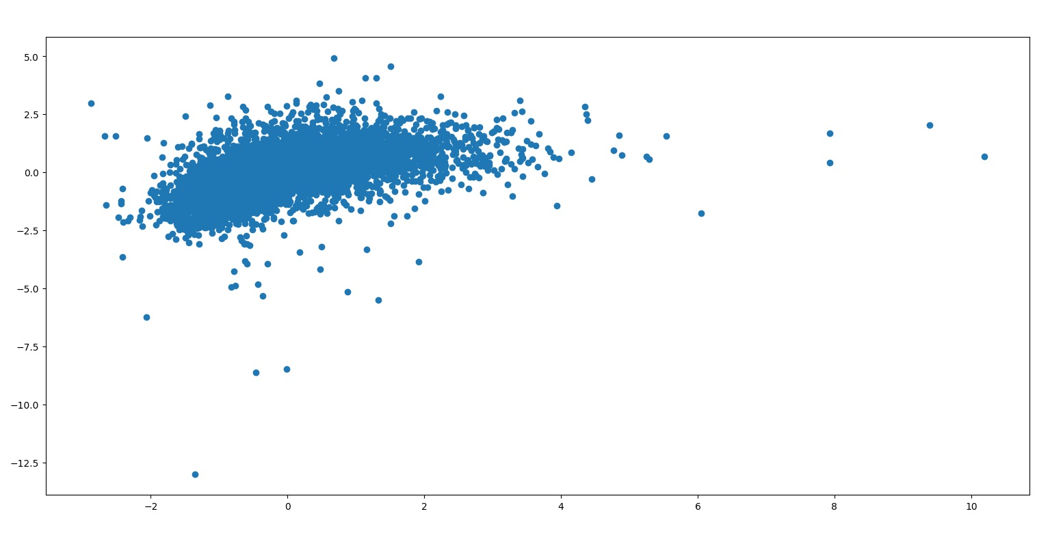
10th result (Homosexuality or Heterosexuality?)
Sex ratio

Slide 30
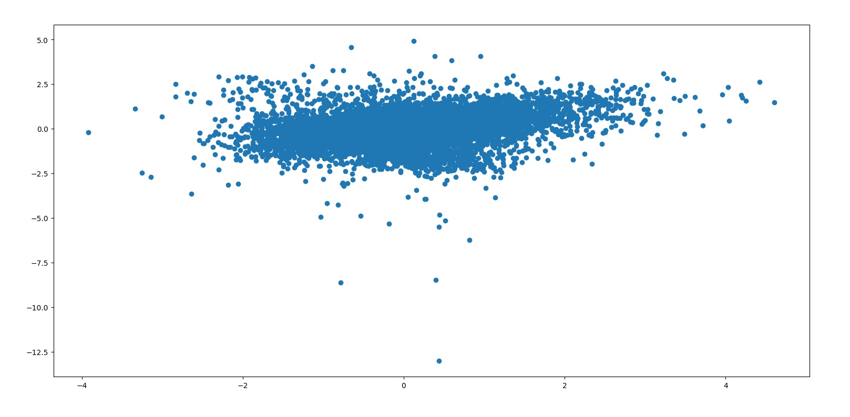
10th result (Homosexuality or Heterosexuality?)
Age weights

Slide 31

10th result (Homosexuality or Heterosexuality?)
Regression: r2 of total features
R2:0.43235

Slide 32
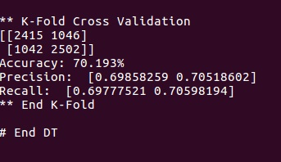
10th result (Homosexuality or Heterosexuality?)
Decision tree: Accuracy of total features
Accuracy: 70.193%

Slide 33

10th result (Homosexuality or Heterosexuality?)
Regression: R2 of three features(total, education, sex ratio)
(R2 top three)
R2:0.484

Slide 34
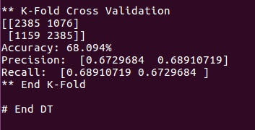
10th result (Homosexuality or Heterosexuality?)
Decision tree: Accuracy of three features(total, education, sex ratio)
(R2 top three)
Accuracy:68.094%

Slide 35

10th result (Homosexuality or Heterosexuality?)
Regression: r2 of three features(marriage, age, education)
R2:0.4675

Slide 36
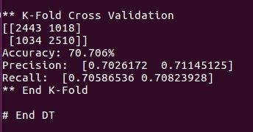
10th result (Homosexuality or Heterosexuality?)
Decision tree: Accuracy of three features(marriage, age, education)
Accuracy:70.706%

Slide 37

10th result (Homosexuality or Heterosexuality?)
Regression: r2 of three features(marriage, age, total)
R2:0.40734

Slide 38
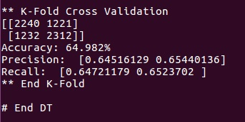
10th result (Homosexuality or Heterosexuality?)
Decision tree: Accuracy of three features(marriage, age, total)
Accuracy:64.982%

Slide 39

10th result (Homosexuality or Heterosexuality?)
Regression: r2 of three features(marriage, age, sex ratio)
R2:0.42013

Slide 40
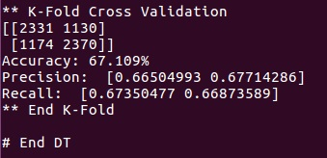
10th result (Homosexuality or Heterosexuality?)
Decision tree: Accuracy of three features(marriage, age, sex ratio)
Accuracy:67.109%

Slide 41
Conclusion of 10th
Total features: good
Three features:
best: marriage,
family, education
Regression: r2 | Decision tree: Accuracy
0.43235 | 70.193%
 | total, education, sex ratio | marriage, age, education | marriage, age, total | marriage, age, sex ratio
Regression | 0.484 | 0.4675 | 0.40734 | 0.42013
Decision tree | 68.094% | 70.706% | 64.982% | 67.109%

Slide 42

Conclusion of 13th
Each one feature:
Top three: Education weights, Sex ratio, Total number
Best: Education weights has large influence
Total number | Education weights | Marriage situation | Household situation | Family weights | Sex ratio | Age weights
0.22926 | 0.50167 | 0.14915 | -0.00914 | 0.15484 | 0.26347 | 0.06844

Slide 43
Conclusion
Finding some amazing results
Results could be used in some social research or political analysis

Slide 44
Thanks for listening

